Slide 1

Dust-Away Rentals
MARKETING PLAN
Affordable. Reliable. Spotless.
Submitted BY: -
(group-1)
Amal Bakhsh
bing Wei
Daksh Parikh
Nikhita Agarwal
Poorna Kothapally

Slide 2


Positioning Statement
Our positioning statement is “Affordable. Reliable. Spotless”
Direct reflection of how our services satisfy a specific consumer
Economical alternative to purchasing cleaning equipment
Reduce the time and energy looking for inexpensive and fail-safe equipment
Believe that the equipment shouldn’t just work like new, it should feel like new
Exceptional after-sales service

Slide 3
Target Market
Aim to provide house cleaning equipment rental services to college students across the Richardson
The four target universities -University of Texas, Dallas, West Coast University, Richland College and University of Phoenix Dallas Campus
Primary reason for choosing college students is- students tend to shift often from one place to another, inconvenient to move the equipment
Live in shared accommodations not have the space to store equipment
Purchasing power of students is low compared to that of working professionals or families

Slide 4

Product
At “Dust-Away Rentals” students have an opportunity to rent a diverse range of equipment
Broom And Dustpan,
Duster
Microfiber Spin Mop And Buck
Carpet Cleaner
Vacuum Cleaner
Heavy-duty Cleaning Solutions
Competitive Pricing
Reliable Equipment
Clean home is the need of the hour

Slide 5

Price
Product | Price | Total Units | Total cost | Weekly Rents
Broom and dustpan | $19 | 35 | $665 | $10.08
Duster | $8 | 35 | $280 | $6.72
Microfiber Spin Mop and Bucket | $20 | 35 | $700 | $20.16
Carpet Cleaner | $85 | 7 | $595 | $39.2
Vacuum Cleaner | $50 | 28 | $1400 | $28
Heavy Duty cleaning solution | $30 | 14 | $420 | $7
Total | $212 | 154 | $4,060 | $111.16
Decided to pay for a minimum viable inventory, during the initial days of business
Intend to purchase more equipment that is high in demand and profitable
It is both cost-effective and convenient to buy more equipment later than to get rid of excess unwanted equipment

Slide 6

Promotion
Push Marketing
Email marketing
newsletters and promotional emails
attractive offers
Flyers on the bulletin boards
Printing does not need a huge budget
Excellent quality flyers can be produced instantly
Visibility of flyers can make our customers feel more associated with the business
Future Strategy
Plan to open brick-and-mortar stores across four strategic locations in the Richardson area
Enable Direct Sales to customers
Benefits of Push Marketing
Maintain customer brand loyalty
Awareness of our new services
Edify the value of our brand
Keep the audience engaged

Slide 7

Promotion
Pull Marketing
Own website
Huge repository of information
SEO Tools will facilitate our website to rank higher
Boosts the brand image in the eye of the customers
Social media marketing
Different social media platforms such as Facebook, Instagram and TikTok
Relevant hashtags for consumers to find our content
More visibility and boosts traffic
Measure the success rate of online campaigns
Unlimited marketing potential

Slide 8
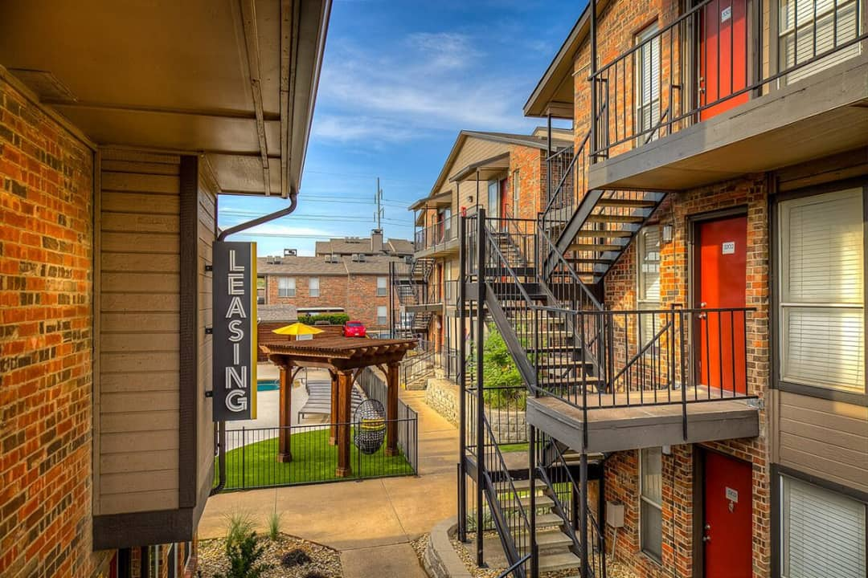
Place/ Distribution
Direct sales
Service will be provided through an online booking platform
Plan to open four stores close to the four target Universities
Will make it convenient for customers to have direct access to our services
control our expenses
stronger customer relationships with our target audience
Indirect sales
Partnerships with the leasing office of popular student accommodations
Keep certain equipment in these offices, consumers can directly walk in and book a service
Work on the Referral model with these housing apartments
Referrals coming from trusted sources will create a positive impact
Established logistics of channel partners give us time to focus on improving services

Slide 9
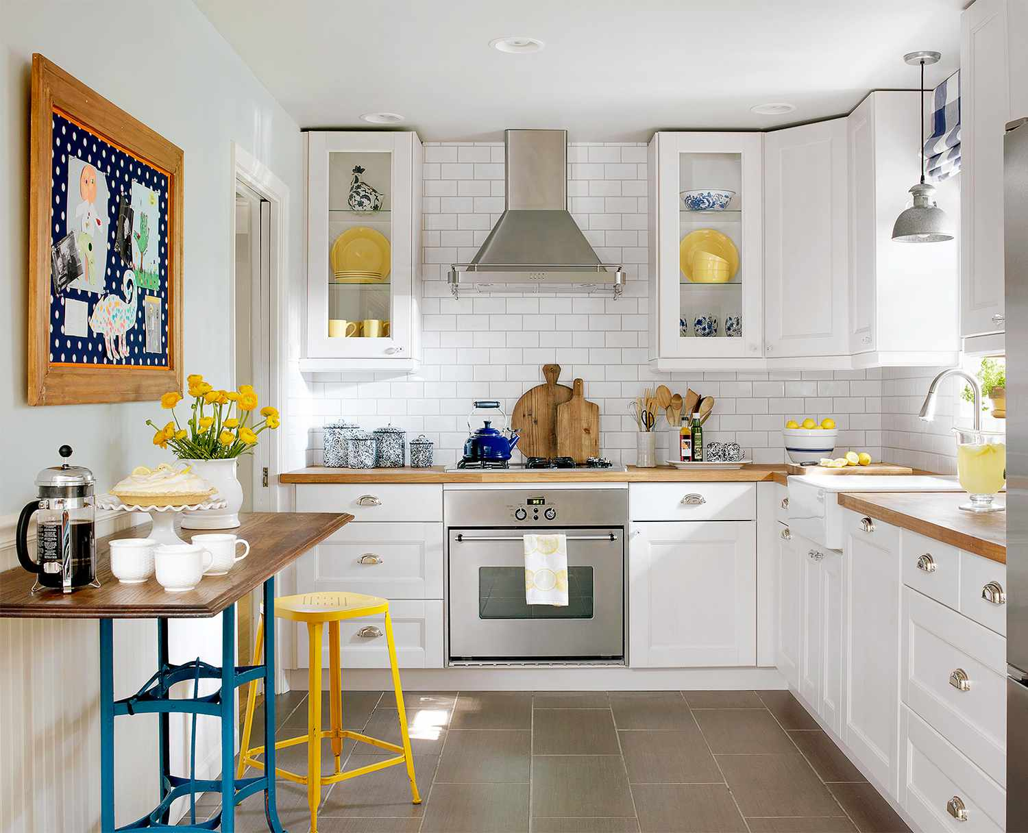
SWOT Analysis
STRENGTHS Easier and more cost-effective No issues with storing or maintaining tools Located in Texas, one of the fast-growing state Diverse range of products Less preliminary fees Less personnel and management cost | WEAKNESSES Difficult to increase brand awareness High cost to educate customers Product lines may be limited
OPPORTUNITIES Trend for Renting on a rise Rental service market has been developing rapidly Social Media Oriented Business Model Audience advantage- influx of new International students every semester | THREATS Economic crisis Controversies with Safety Measures Government laws

Slide 10
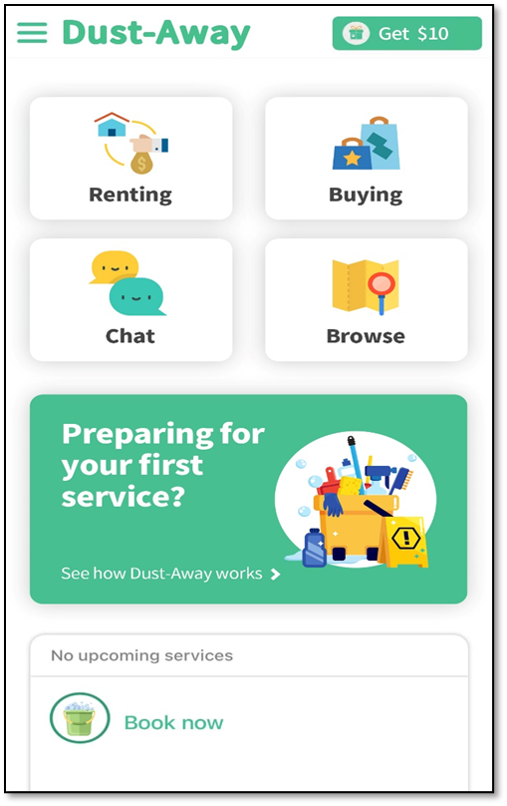
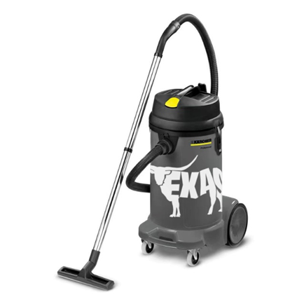

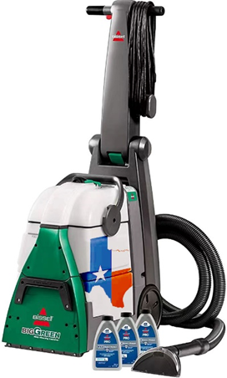
Sample Ads and Flyers

Slide 11

Thankyou
Questions & Feedback

